Slide 3
Welcome to
Making your Club
April 20, 2024

Slide 4
v
Club Experience Matters the Most
Why do you go back to your club each week?
How do we make it better?
Notes:
4
4
Important topics in programs
Fun to be with friends
Love the fabulous projects the club does
Our impact on the community –
How do know if we are Irresistible?
Survey your club via MAP or other method. Main question is:
“What would you change about our club?”

Slide 5
subhead
Set the Stage
ALL about The Atmosphere
Everything a Club does:
Meetings
Service Projects
Social Gatherings
This is STEP ONE
Notes:
So let us look at some items that may be considered less than attractive
Meal provision - the tradition of a set meal, at set cost, whether you attend or not, can be a significant barrier to prospective members and also a source of angst with current members.
The trend for meal flexibility has been very apparent recently, with optional and no meals both becoming more popular.
Then there is the preponderance for meetings during the day Monday to Friday - this has generally been the basis for most clubs traditionally but we have become very aware that we are only capable of attracting those who can meet that specific timeframe.
Evenings and weekends certainly offer new opportunities.
Of course if it works for you - that’s fine, but the flexible approach has been far more prevalent lately and this is also true of the meeting format - traditionally it was the same meeting format each week, but many clubs have departed from that, and introduced flexible formats
- with traditional meetings interspersed with service opportunities, social events, online meetings and not forgetting the opportunity for less frequent meetings.
And when you add the 1 to 1 and 1/2 hour meeting time, to the traveling time to get to the meeting and back,
this can mean we are restricting the club’s membership to those people who can afford to write off 2-3 hours during their working day.
Sometimes our Rigid Rituals can come as a shock to potential members
Our Invocations should also have regard to the diversity of our organization’s membership, this is all an integral part of our inclusiveness.
And most of our traditional clubs still hand over a large part of the meeting to speakers - fine if you can consistently get quality, informative and entertaining speakers,
but not so good if you have a constant parade of charities and organizations looking to fatten their coffers with the funds of good hearted Rotarians, who quite honestly already have the best charity in the world in house - Our very own Rotary Foundation.
Now some or all of these may work for you, but we should be sure that we are not just continuing with the ‘we’ve always done it this way’ syndrome,
and really take a look at what gives value to our current and prospective members, value for their time, value for their treasure, value for their commitment to service.

Slide 6
Personal
Connection
If you want to ENGAGE someone, build a relationship with them
Stronger Bonds
Longer Lasting

Slide 7
Community Connection
Become "Tip of the Spear"
Effective Service
Compelling Public Image

Slide 8
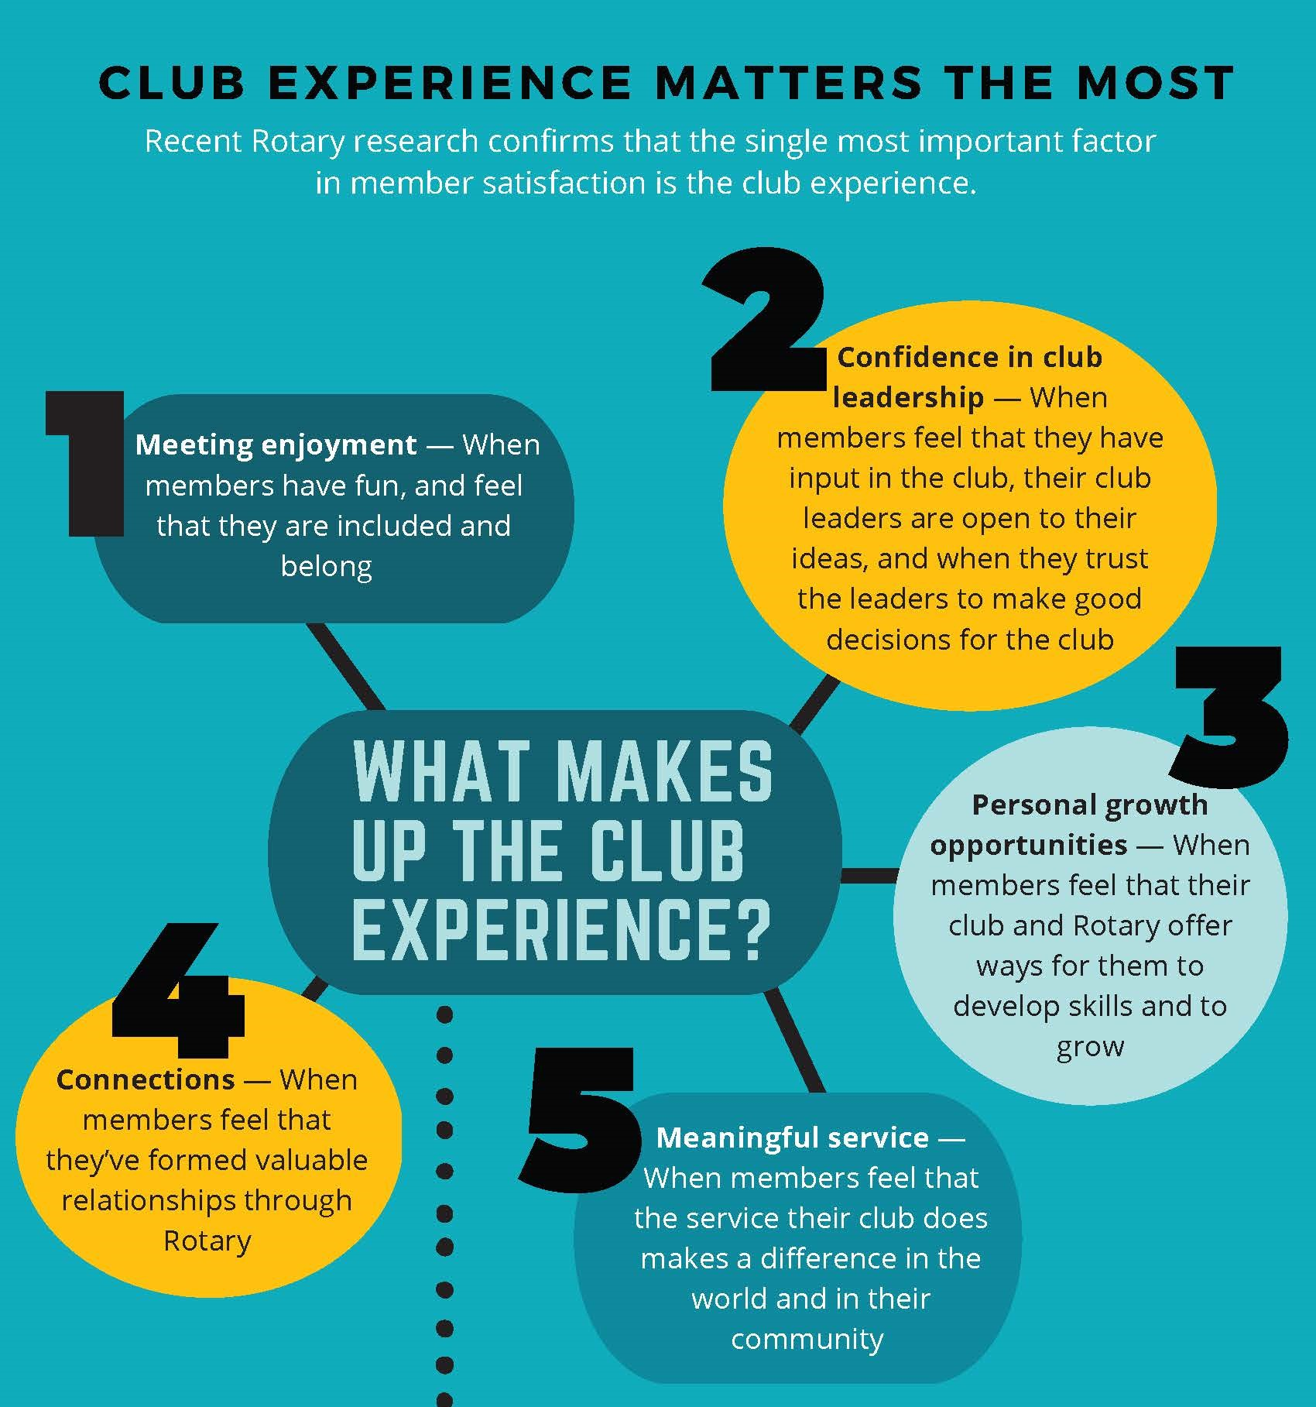
Notes:
All comes back to Atmosphere/Environment
Using all your senses to be Irresistible
See
Sound
Taste
Smell
Touch
Also Space

Slide 9
Set the Stage
Build Relationships
Create Community Connections
Start-Up Materials Available
www.rizones33-34.org/?s=irresistible
Notes:
As you can see, there are circumstances beyond our control that create barriers for entering Rotary and sometimes for remaining in Rotary.
You may be thinking that this all sounds great in theory, but wonder how it works in practice. So let me just tell you. In my club, our membership numbers had slowly been declining from 135 to 75 over the course of 15 years.
Club leadership decided to be intentional about focusing on removing barriers and creating opportunities for membership.
Through implementation of the Active Service and Active Social membership options, we gained 7 new members and retained 8 and grew our total membership to its current total at 87. That means that currently, 15% of our club members exist as a result of alternative membership types.

Slide 10
Questions

